Slide 1
Module 2 2G Technologies
Network Structure
Cell
A cell is the basic unit of a cellular system and is defined as the radio coverage given by one BTS.

Slide 2
Network Structure
LOCATION AREA
A LA is defined as a group of cells. Within the network, a subscriber's location is known by the Location Area which they are in.

Slide 3
Network Structure
MSC Service Area
An MSC Service Area is made up of LAs and represents the geographical part of the network controlled by one MSC.

Slide 4
Network Structure
A public land mobile network (PLMN) service area
the area in which an operator offers radio coverage and access to its network.

Slide 5
Network Structure
GSM SERVICE AREA
The GSM service area is the entire geographical area in which a subscriber can gain access to a GSM network

Slide 6
Relation between areas in GSM
Location Area
Cell
Location Area
MSC Service Area
PLMN Service Area
GSM Service Area

Slide 7
Mobile Station
GSM MSs consist of
Mobile Equipment
Subscriber Identity Module

Slide 8
Functions of Mobile Station
Voice and data transmission & receipt
Frequency and time synchronization
Monitoring of power and signal quality of the surrounding cells
Provision of location updates even during inactive state

Slide 9
Mobile Station
Can receive, store, send SMS up to 160 characters.
MS identified by unique IMEI shown on pressing *#06#.
Power levels of 20W, 8W, 5W, 2W and .8W

Slide 10
SIM(Subscriber Identity Module)
SIM has microprocessor and memory.
Fixed data stored for the subscription:
International Mobile Subscriber Identity (IMSI)
Authentication Key
Security Algorithms
personal identification number (PIN) & PIN unlock key (PUK)

Slide 11
Network Identities
International Mobile Equipment Identity (IMEI)
The IMEI is an unique code allocated to each mobile equipment. It is checked in the EIR.
IMEI check List
White List
Grey List
Black List

Slide 12
Network Identities
Mobile Station ISDN Number
The MSISDN is registered in the telephone directory and used by the calling party for dialing.
MSISDN shall not exceed 15 digits.
NDC--National Destination Code
SN--Subscriber Number

Slide 13
Network Identities
International mobile subscriber Identity
The IMSI is an unique identity which is used internationally and used within the network to identify the mobile subscribers.
The IMSI is stored in the subscriber identity module (SIM), the HLR, VLR database.

Slide 14
Network Identities
Mobile Station Roaming Number
MSRN--is a temporary identity which is assigned during the establishment of a call to a roaming subs.

Slide 15
BASE STATION SYSTEM (BSS)
MSC/VLR
BSC
BSC
BSC
BSS
n BTS
n BTS

Slide 16
FUNCTIONS OF BTS
Signal Processing
Signaling link management
Synchronization
Local maintenance handling
Functional supervision and Testing

Slide 17
VISITOR LOCATION REGISTER (VLR)
It contains data of all mobiles roaming in its area.
One VLR may be in charge of one or more LA.
VLR is updated by HLR on entry of MS its area.

Slide 18
Home Location Register(HLR)
Reference store for subscriber’s parameters, numbers, authentication & Encryption values.
Current subscriber status and associated VLR.
Both VLR and HLR can be implemented in the same equipment in an MSC.

Slide 19
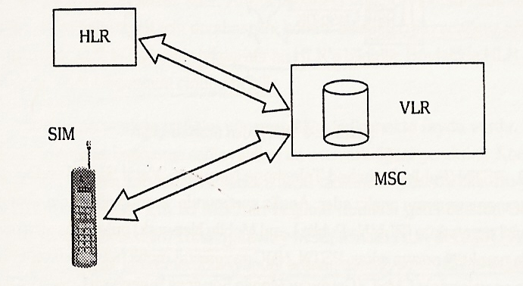
Databases of GSM Network

Slide 20
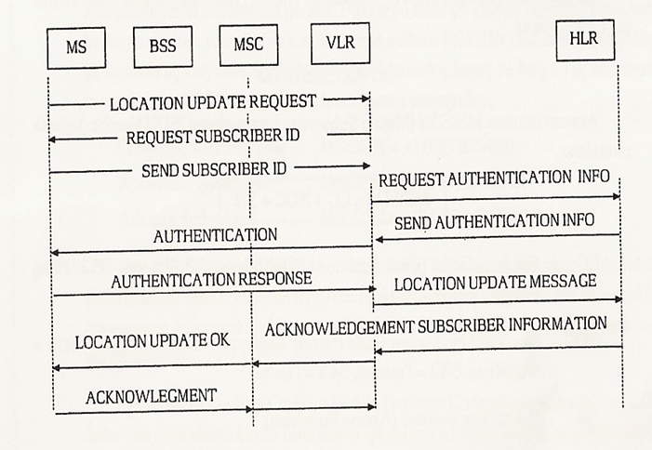
Procedure of Location Update

Slide 21
SET UP CALLS IN GSM NETWORK
+90 400 398 0102
MSISDN = CC + NDC + SN
CC : Country Code
NDC : National Destination Code
SN : Subscriber Number
GMSC : Gateway Mobile Services Switching Center

Slide 22
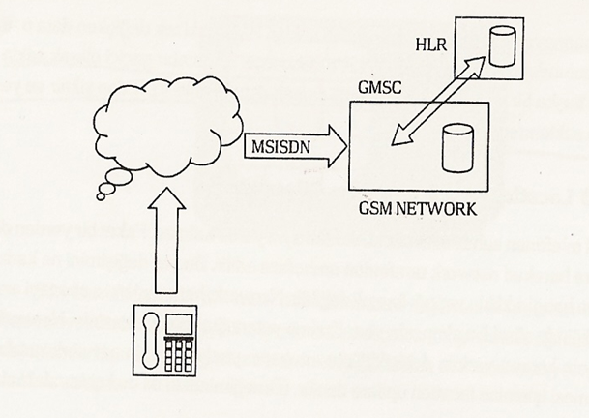
REACH CALLS FROM PSTN TO GSM NETWORK

Slide 23
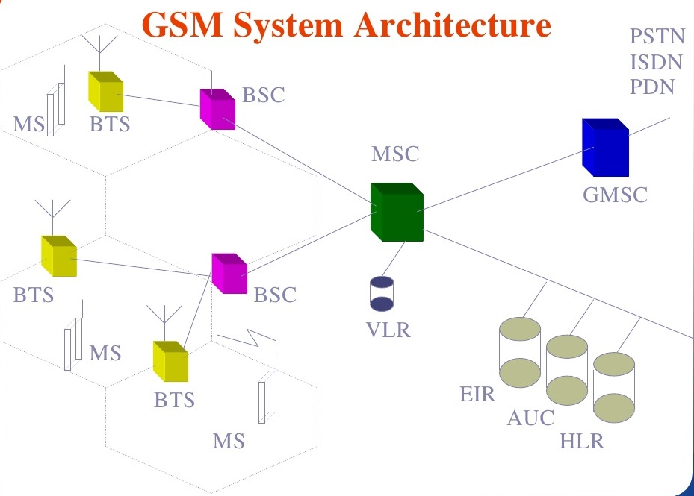
GSM Architecture

Slide 24
EQUIPMENT IDENTITY REGISTER ( EIR )
This data base stores IMEI for all registered mobile equipment and is unique to every ME.
Only one EIR per PLMN.
White list : IMEI, assigned to valid ME.
Black list : IMEI reported stolen
Gray list : IMEI having problems like faulty software, wrong make of equipment etc.

Slide 25
AUthentication Center (AUC)
To authenticate the subscribers attempting to use a network.
AUC is connected to HLR which provides it with authentication parameters and ciphering keys used to ensure network security.

Slide 26
AUC Functions
To perform subscriber authentication and to establish ciphering procedures on the radio link between the network and MS.

Slide 27
AUC Functions
Information provided is called a TRIPLET consists of:
RAND(non predictable random number)
SRES(Signed response)
Kc(ciphering key)

Slide 28
Operation Maintenance Centre
The centralized operation of the various units in the system and functions needed to maintain the subsystems.
Dynamic monitoring and controlling of the network

Slide 29
Functions of OMC
-O&M data function
-Configuration management
--Fault report and alarm handling
-Performance supervision/management
-Storage of system software and data

Slide 30
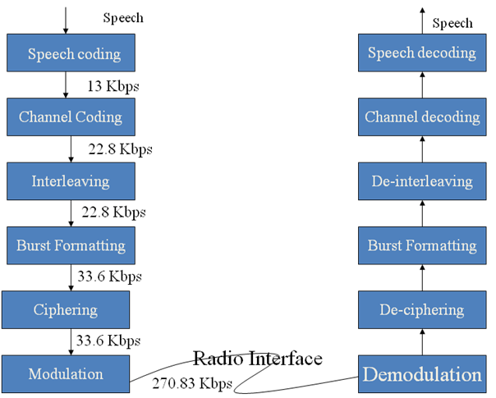
GSM Operation

Slide 31
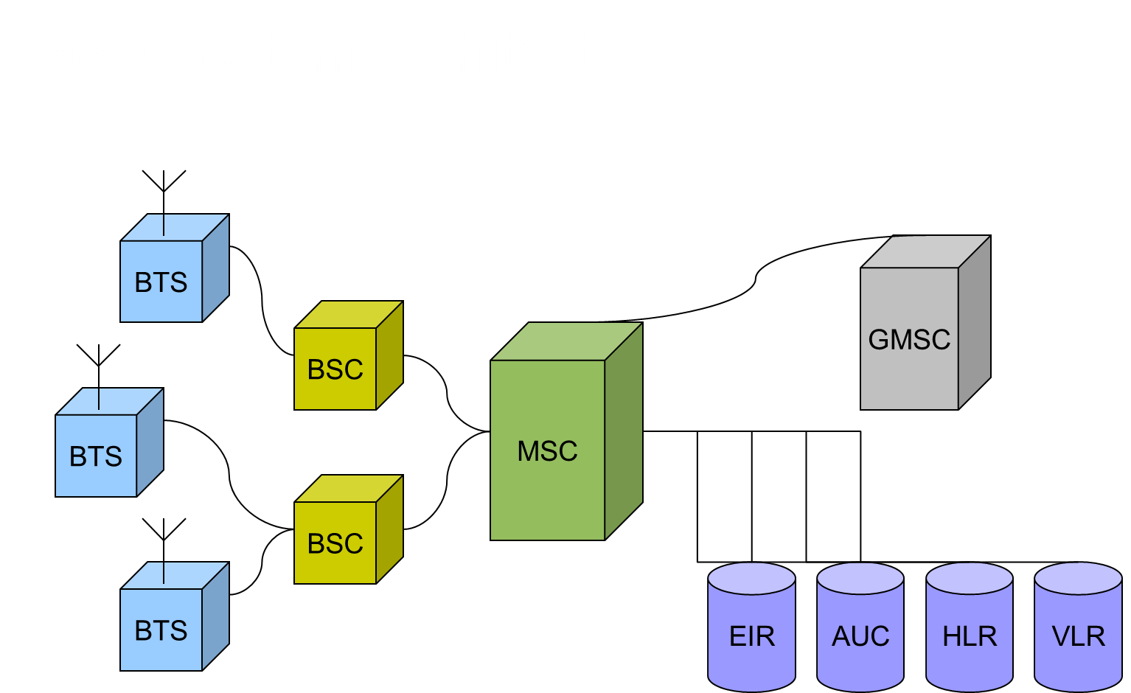
GSM Architecture

Slide 32
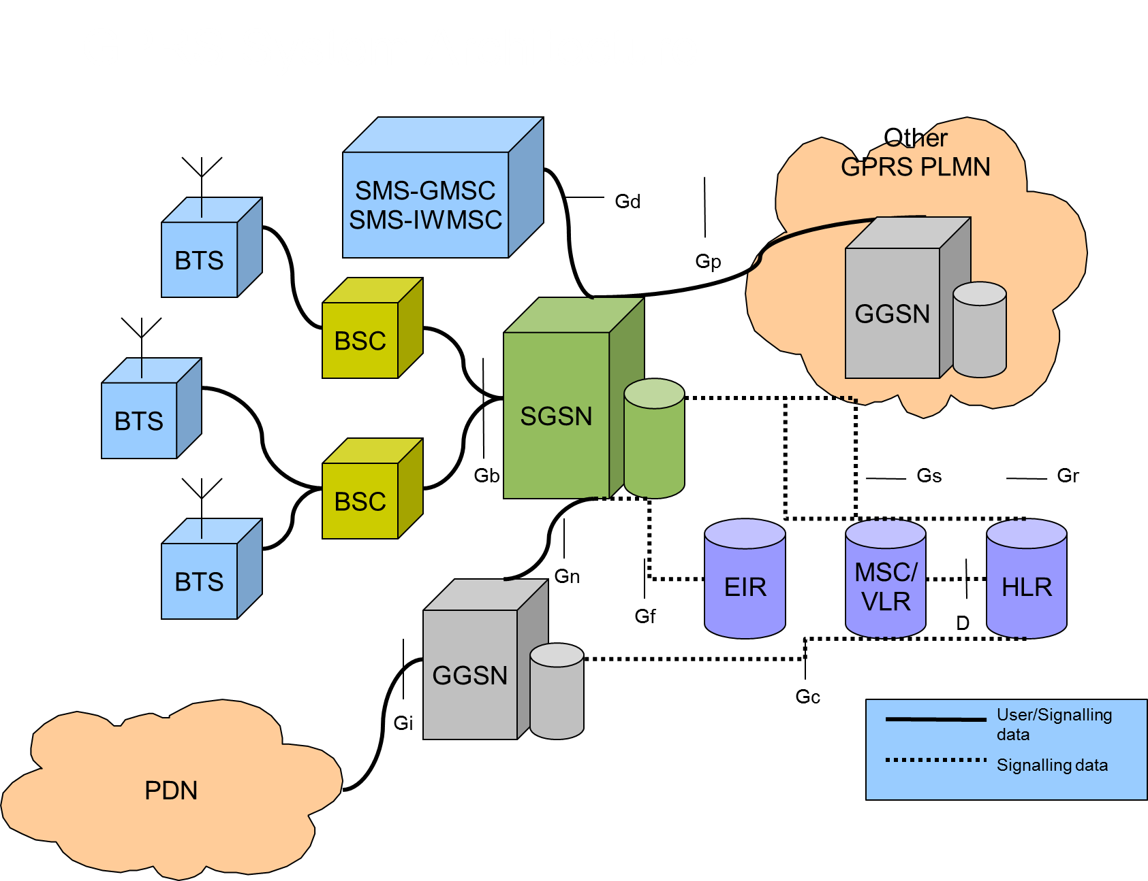
GPRS Architecture

Slide 33
GPRS - MS
SGSN – Serving GPRS Support Node
GGSN - Gateway GPRS Support Node
GSM/GPRS services can be used in parallel. Three classes of mobile station:
Class A – Simultaneous use of GSM and GPRS
Class B – Can register for both GSM and GPRS, but only use one at a time
Class C – Can attach for only either GSM or GPRS (with the exception of SMS messages)

Slide 34
Disadvantage of Digital System in 2G
Cellular towers had a limited coverage area.
Abrupt dropped calls due to uneven decay curve.
Spotty Coverage.
Data services were not supported.

Slide 35
GPRS - Introduction
GPRS (General Packet Radio Service) is an overlay on top of the GSM physical layer and network entities.
It is a packet-switched technology that enables data communications over GSM network, often described as 2.5G
It does not setup a continuous channel from a portable terminal for the transmission and reception of data, but transmits and receives data in packets, thus enabling efficient use of the available radio spectrum.

Slide 36
GPRS - Introduction
It uses exactly the same physical radio channels as GSM, only logical GPRS radio channels are defined.
Allocation of the channels is flexible: from one to eight radio interface time slots can be allocated per TDMA frame.
Bursty data is well handled by GPRS.
It is not well suited for real –time applications.
It is suited for non-real time applications such as e-mail and web surfing.

Slide 37
GPRS Gateways
1.Serving GPRS Support Node (SGSN):
In GPRS network SGSN is equivalent to MSC. Packets of data between MSC and Public Switch Data Network (PSDN) are transferred and received by SGSN.
2.Gateway GPRS Support Node (GGSN):
GSM data base e.g. HLR and VLR are supported by GGSN. It also interacts with external packet-switch networks.

Slide 38
GPRS - SGSN
Delivers data packets to mobile stations & vice-versa
Detect and Register new GPRS MS in its serving area
Packet Routing, Transfer & Mobility Management
Authentication, Maintaining user profiles
Its location register stores location info. & user profiles

Slide 39
GPRS - GGSN
Interfaces GPRS backbone network & external packet data networks
Converts the GPRS packets from SGSN to the (Packet data protocol ) PDP format
Converts PDP addresses change to GSM addresses of the destination user
Stores the current SGSN address and profile of the user in its location register
Performs authentication

Slide 40
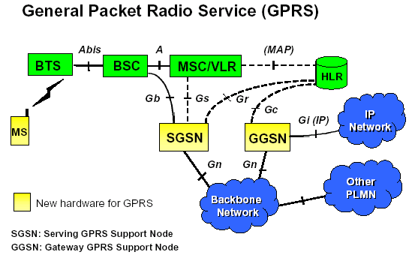
GPRS Back bone Network

Slide 41
GPRS – Mobile Station
All GPRS-MS are backward compatible with GSM systems for making voice calls using GSM network.
They are of 3 types:
Class A- Support Simultaneously GPRS and GSM services.
Class B- It can monitor all GSM and GPRS channels simultaneously, but operate either GPRS or GSM at a time.
Class C-It supports only GPRS services

Slide 42
GPRS BACK BONE NETWORKS
They are of two types:
Intra-PLMN –It allows SGSNs and GGSNs of one service provider to communicate with each other via Gn interface.
Inter-PLMN-It allows SGSNs and GGSNs of different service provider to communicate with each other via GP interface.

Slide 43
GPRS – LOCATION MANAGEMENT
It depends on three states of the mobile user in which it can operate
Idle state - The mobile user is not reachable by the network and the contexts of packet data protocol are deleted.
Standby state - Movement across routing areas is updated to the SGSN but not across cells.
Ready state - Every movement of the mobile user is indicated to the SGSN.

Slide 44
GPRS MOBILITY MANAGEMENT
Data is transmitted between MS and GPRS network only when MS is in active state. In it SGSN know the exact location of the MS.
Mobility Management deals with handoff initiation.
Power Control and security mechanisms are implemented in the similar way as done in GSM.
A logical link is established and maintained between the MS and the SGSN in each mobile network.

Slide 45
GPRS ADVANTAGES
Short access time to the network for independent short packets (500-1000bytes).
No hardware changes to the BTS/BSC.
Easy to scale.
Support for voice/data and data only terminals.
High throughput(upto21.4kbps).
User friendly billing.

Slide 46
GPRS CHALLENGES
Limited Cell Capacity.
Lower data speeds.
Transit Delays.
No Store and forward.
Tariff and billing.

Slide 47
EDGE
EDGE / EGPRS implemented as enhancement for 2G and 2.5G GSM and GPRS networks for relatively easy upgrade
Base stations (BS) and base station controllers (BSC) have to be modified for EDGE compatible transceiver units
Requires new mobile terminal (MT) hardware and software for decode/encode the new modulation and coding schemes
Additionally to Gaussian minimum-shift keying (GMSK) higher-order PSK/8 phase shift keying(8PSK) used

Slide 48
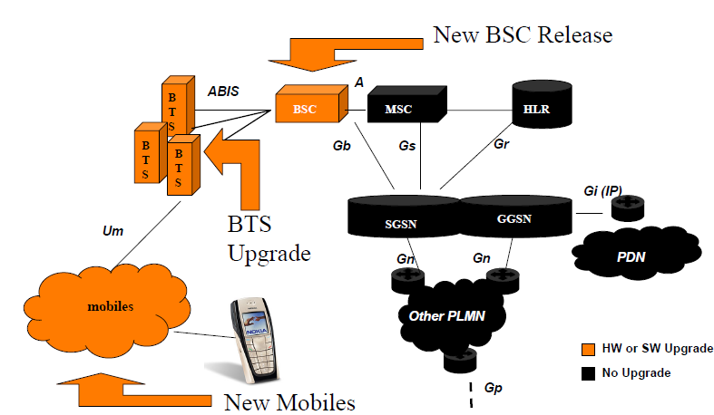
EDGE ARCHITECTURE

Slide 49
EDGE
EDGE systems inherits almost all its features from GSM and GPRS
EDGE could be directly implemented in an existing GSM system
For those users not having an EDGE equipped mobile phone, it is fully compatible with existing GSM as well as GPRS.
It defines 9 air interface formats known as Modulation and Coding Schemes with varying degrees of error control protection

Slide 50
EDGE
EDGE carries up to 236.8 kbit/s for 4 time slots
Because of physical layer enhancements HSCSD data rates are increased too.
EDGE can be used for any packet switched application, such as an Internet connection.

Slide 51
EDGE
The introduction of “ high band width ” data services allows more than SMS services.
MMS is the abbreviation for Multimedia Messaging Service
Defined by several organizations for GSM and UMTS networks
Common standard for the mobile phones of different vendors

Slide 52
EDGE - CONCLUSION
EDGE is a 3G technology offering a common migration path and convergence for GSM and TDMA operators
EDGE supports IP packet data at peak rates > 384kbps
Voice over IP is planned for EDGE
EDGE enables significantly higher peak rates, and approximately triples the spectral efficiency

Slide 53
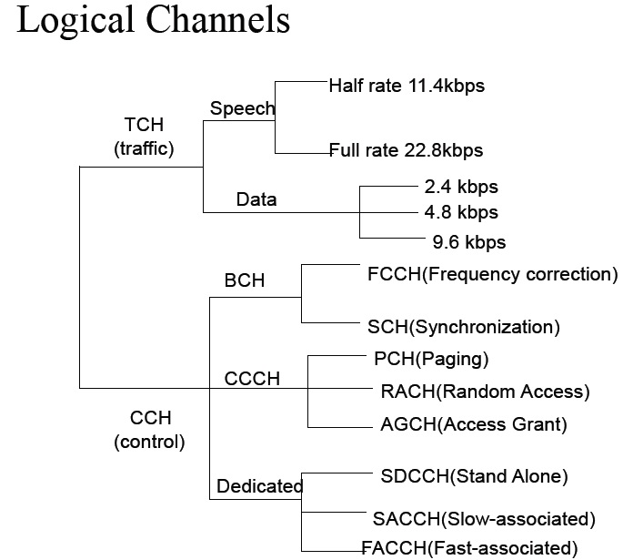
GSM Channels

Slide 54
LOGICAL CHANNELS
The combination of time slot number and an ARFCN(Absolute radio frequency channel number) constitutes a physical channel for both forward and reverse links.
Each physical channel in a GSM can be mapped into different logical channels at different times.
Communication between the MS and BS is involved with both voice as well as signaling and control.
Voice and signaling are inserted in hierarchy and MS use counters to identify the location of a specific packet burst in the overall structure of the frame.

Slide 55
CONTROL CHANNELS
Three types of control channels are defined in GSM:
BCH CCCH DCCH
BCH: It is used by BTS to broadcast system parameters such as frequency of operation in the cell operator identifiers, cell ID and available service of all MSCs.
It also broadcasts a list of channels that are currently in use within the cell.
It is used for signal strength measurement for handoff.
FCCH is used by BTS to broadcast frequency references and frequency correction burst of 148 bit length.
SCH is used by BTS to broadcast frame synchronization signals containing the synchronization training sequences burst of 64 bits length to all MSCs.
It is transmitted once every ten frames within the control channel multi frame.

Slide 56
CONTROL CHANNELS
CCCH: It is a one way channel used for establishing links between the MS and BS, they are used to page specific subscribers, assign signaling channels to specific users and receive mobile request for service.
PCH: It is a forward link channel and is used by BTS to page or notify a specific individual MS for an incoming call in the cell.
It transmits IMSI number of the target subscriber along with a request for acknowledgement from the mobile unit in RACH.

Slide 57
CONTROL CHANNELS
RACH : It is reverse link channel and is used by the MS either to access the BTS requesting the dedicated channel for call establishment or to acknowledge a page from PCH.
AGCH: It is used by BS to provide forward link communication to mobile for implementation of the acknowledgement from the BTS to MS after successful attempt by using RACH in a previous CCCH frame.
It is also used by BS to send information about timing and synchronization to the MS.

Slide 58
CONTROL CHANNELS
DCCH: It is a two –way channel having the same format and function on both forward and reverse links, supporting signaling and control for individual mobile subscribers and are used along with voice channels to serve for any control information transmission during actual voice communication.
SDCCH: It is allocated with SACCH to enable mobile terminal to transfer network control and signaling information for call establishment and mobility management.
SACCH: It is used to exchange necessary parameters between BTS and MS during the actual transmission to maintain the communication link. Its data rate is half of that of SDCCH.
FACCH: It supports fast transitions such as a hand off request in the channel. It is multiplexed with TCH and SDCCH to provide additional support to the SACCH.

Slide 59
TRAFFIC CHANNELS
Voice channels are called traffic channels in GSM. They are two way channels for carrying voice and data traffic between BS and MSC.
Frames of TCH data are broken up every thirteenth frame by either SACCH or idle frames.

Slide 60
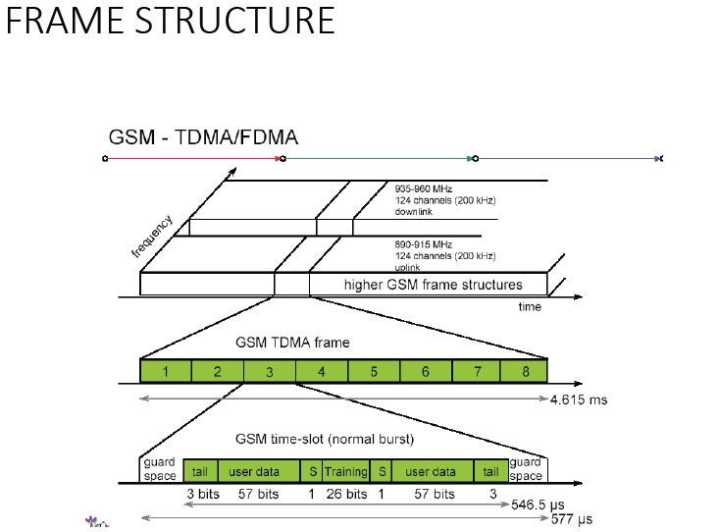
FRAME STRUCTURE

Slide 61
FRAME STRUCTURE
Frequency band of operation.
Number of Logical channels or Number of Time Slots in TDMA frame-8
Channel Bandwidth- 200KHz
Maximum Cell radius-35km
Maximum Vehicle Speed-250km/h
Maximum Delay Spread-10s
Maximum coding delay-20ms

Slide 62
GSM Security
Access Control and Authentication
User should not be able to use the GSM resources without being authenticated
Confidentiality
Messages containing user related information should not be accessible to others
Anonymity
User identifier is not used over the air Confidentiality (Privacy from eavesdropping)
Temporary encryption key is used for privacy of data, signaling, and voice Information is encrypted before transmission

Slide 63
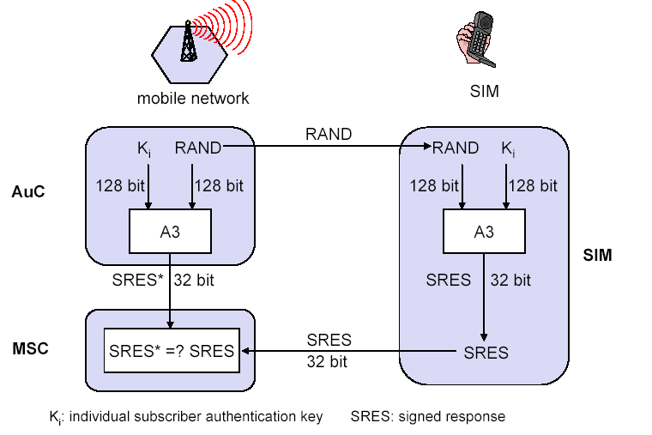
AUTHENCATION PROCESS AND CIPHERING KEY GENERATION

Slide 64
GSM: Identification
Identification of Mobile Subscriber
International Mobile Subscriber Identity (IMSI)
Temporary IMSI (TMSI)
Mobile Subscriber ISDN number (MSISDN)
Identification of Mobile Equipment
International Mobile Station Equipment Identification (IMEI)
Mobile Station Roaming Number (MSRN)

Slide 65
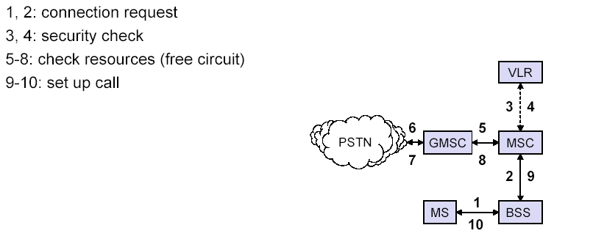
MOBILE ORIGINATED CALL

Slide 66
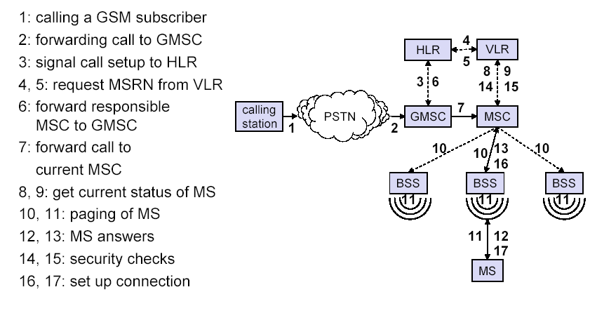
MOBILE CALL TERMINATION

Slide 67
Advantages of GSM over Analog system
Capacity increases
Reduced RF transmission power and longer battery life.
International roaming capability.
Better security against fraud (through terminal validation and user authentication).
Encryption capability for information security and privacy.
Compatibility with ISDN, leading to wider range of services.
MAHO.

Slide 68
CDMA Basics - Outline
How CDMA Works
CDMA signal generation
Types of code used in CDMA
Forward and Reverse code channels
CDMA Call processing.

Slide 69
Spread Spectrum (SS)
A transmission technique in which a pseudo-noise (PN) code, independent of the information data, is employed as a modulation waveform to “spread” the signal energy over a BW much greater than the signal information BW. At the receiver the signal is “despread” using a synchronized replica of the pseudo-noise code.
The word ”Code” and “division” are important parts of how CDMA works.
CDMA uses codes to convert between analog voice signals and digital signals.
CDMA also uses codes to “separate ( or divide) voice and control data into data streams called “channels”.
These digital data stream channels should not be confused with frequency channels.

Slide 70
Generation of CDMA Signal
There are five steps in generating a CDMA signal.
analog to digital conversion
Vocoding
encoding and interleaving
channelizing the signals
conversion of the digital signal to a Radio Frequency (RF) signal

Slide 71
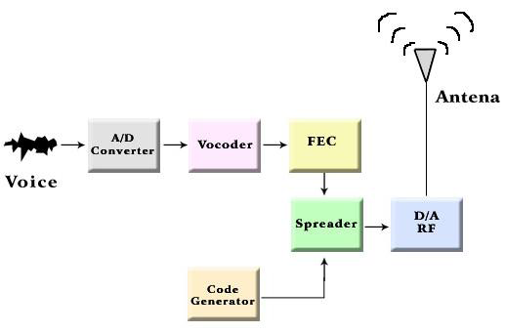
Generation of CDMA Signal

Slide 72
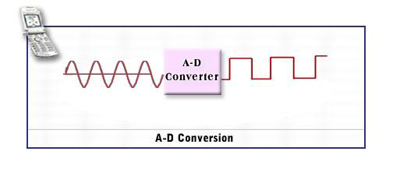
A-D Conversion
The first step of CDMA signal generation is A to D conversion.
CDMA uses a technique called PCM to accomplish A/D conversion.

Slide 73
Voice Compression
CDMA uses a device called a vocoder to accomplish voice compression.
The term “vocoder” is a contraction of the “voice and “code”.
Vocoders are located at BSC and in the phone.

Slide 74
How Compression works
People pause between syllables and words when they talk.
CDMA takes advantage of these pauses in speech activity by using a variable rate vocoder.

Slide 75
Variable Rate Vocoder
A CDMA vocoder varies compression of the voice signal in to one of four data rates based on the rate of the user’s speech activity.
The four rates are ,Full,1/2,1/4 and 1/8.
The vocoder uses its full rate when a person is taking very fast .
It uses the 1/8 rate when the person is silent or nearly so.

Slide 76
Encoding and Interleaving
Encoders and interleaver are built into the BTS and the phones.
Encoding and interleaving is a mechanism for ensuring that the effect of data-loss during transmission can be recovered.

Slide 77
How encoding works
The types of encoding done at this stage is called “convolution encoding.”
A simplified encoding is the repetition code :
Each bit is repeated three times.
These encoders bits are called symbols.
The decoder at receiver uses a majority logic rule.
Thus ,if an error occurs, the redundancy can help recover the lost information.

Slide 78
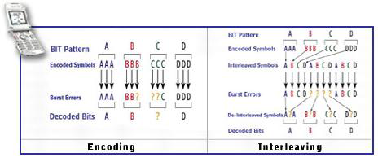
Encoding and Interleaving

Slide 79
Burst errors
A burst errors is a type of error in received digital telephone signals.
Bursts errors occur in clumps of adjacent symbols.
These errors are caused by fading and interference.
Encoding and interleaving reduce the effects of burst errors.

Slide 80
How interleaving works
It is simple but powerful method of reducing the effects of burst errors and recovering lost bits.
In example shown here the symbols from each group are interleaved in a pattern that the receiver knows.
De-interleaving at receiver unscrambles the bits, spreading any burst errors that occur during transmission.

Slide 81
Channelizing
The encoded and interleaved voice data for a user is further encoded to distinguish it from encoded voice data for other users.
The encoded symbols are then spread over the entire B.W. of the CDMA channel.
This process is called channelization.
The receiver knows the code and uses it to recover the voice data.

Slide 82
PN codes
Pseudorandom Noise (PN) codes uniquely identify users.
The PN codes in CDMA yield about 4.4 trillion combinations of code.
This is a key reason why CDMA is also secure.

Slide 83
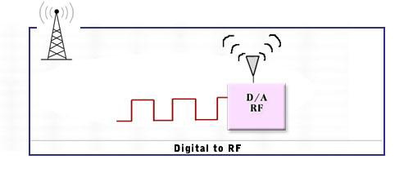
Conversion of Digital Signal to Radio Frequency
Finally, the encoded signals are converted into radio frequency signals, as the digital signals can’t travel longer distance.

Slide 84
Conversion of Digital Signal to Radio Frequency
The BTS combines channelized data from all calls into one signal.
It then converts the digital signal to a radio frequency (RF) signal for transmission.

Slide 85
Reception of CDMA Signals
After CDMA signal is transmitted ,the receiver must reverse the signal generation process to recover the voice, as follows:
conversion of RF signal to digital signal
Despreading of signal
Deinterleaving and decoding
Voice decompression
Digital to analog voice conversion

Slide 86
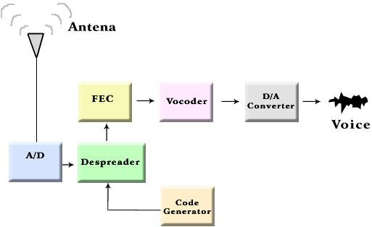
Reception of CDMA Signals

Slide 87
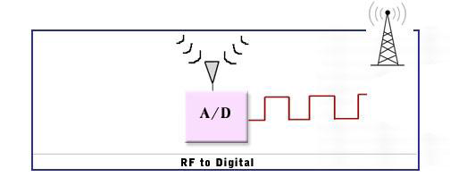
Conversion of RF Signal to Digital Signal

Slide 88
Despreading the Signal
The despreading stage of signal reception reverses the effect of channelization, to produce a strong signal that can be used by the subsequent stages in the reception mechanism.

Slide 89
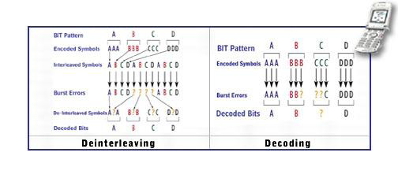
Deinterleaving and Decoding

Slide 90
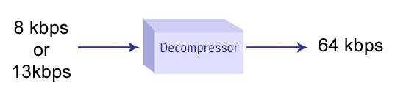
Voice Decompression

Slide 91
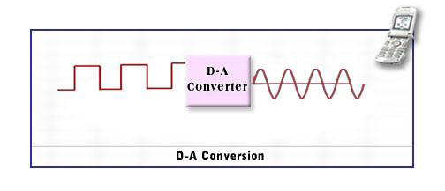
D-A Conversion

Slide 92
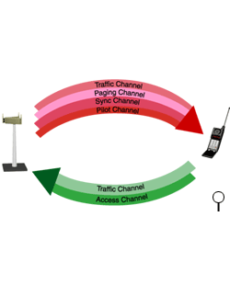
CODE CHANNELS USED IN CDMA
A code channel is a stream of data.
Channel may be voice or overhead control data.
Channels are separated by codes.
The forward and reverse links use different types of channels.

Slide 93
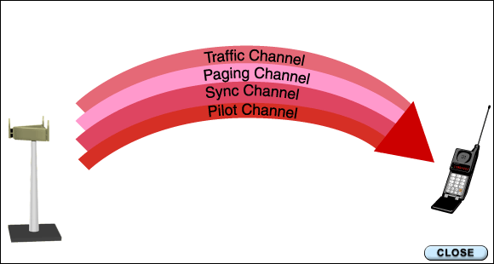
FORWARD LINK CHANNELS
It is used to transmit voice data and control data to the mobile
Pilot
Sync
Paging
Traffic

Slide 94
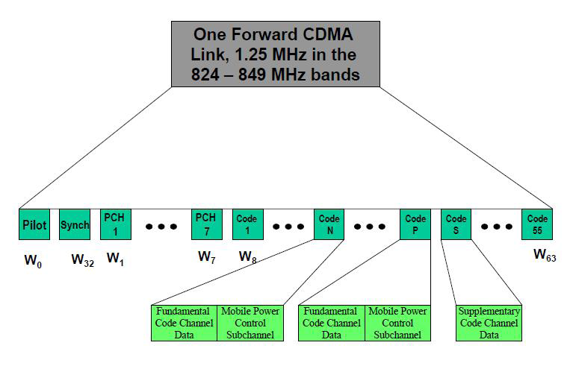
FORWARD LINK STRUCTURE

Slide 95
Pilot channel
The BTS constantly transmits the pilot channel.
The mobile uses the pilot signal to acquire the system.
It uses the pilot signal to monitor and adjust the power needed in order to transmit back to the BTS

Slide 96
Sync Channel
The BTS constantly transmits over the sync channel so the mobile can synchronize with the BTS.
It provides mobile with the system time and the identification number of the cell.
The mobile ignores the sync channel after it is synchronized.

Slide 97
Paging Channel
CDMA uses up to seven paging channels
The paging channel transmits overhead information such as commands and pages to the mobile.
The paging channel also sends commands and traffic channel assignment during call set-up.
The mobile ignores the paging channel after a traffic channel is established.

Slide 98
Forward Link traffic channel
CDMA uses between 55 and 61 traffic channel to send both voice and control data during a call.
Once a call is completed, the mobile tunes back into the paging channel for commands and pages.

Slide 99
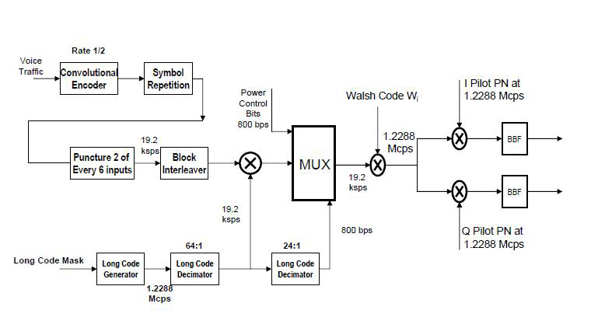
MODULATION PROCESS FOR IS 95 FORWARD TRAFFIC CHANNEL

Slide 100
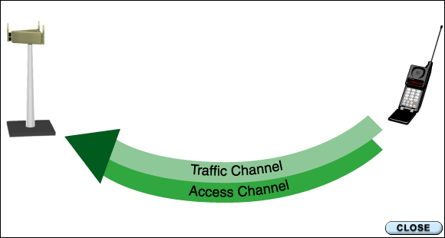
Reverse link channels
Reverse link channels
Access
Traffic

Slide 101
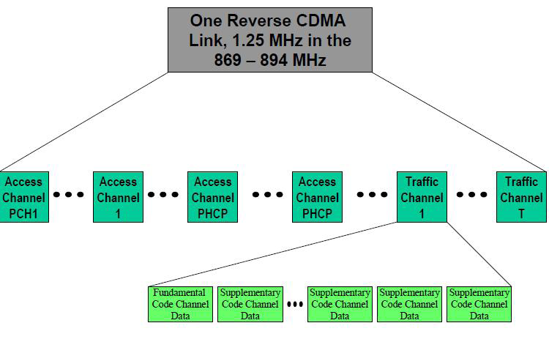
REVERSE LINK STRUCTURE

Slide 102
Access channel
The mobile uses the access channel when not assigned to a traffic channel. The mobile uses the access channel to:
Register with the network
32 Access Channels
Originating calls
Respond to pages and commands from the BS.
Transmit overhead messages to the BS.

Slide 103
Reverse link traffic channel
The reverse link traffic channel is only used when there is call.
62 Traffic channels.
The reverse link traffic channel transmits voice data to the BTS
Also transmits the overhead control information during the call.

Slide 104
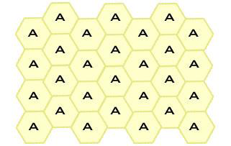
CDMA Planning for Frequency Reuse
In CDMA networks, adjacent cells can transmit at the same frequency.

Slide 105
Call processing stages
There are 4 stages or modes in CDMA call processing:
Initialization mode
Idle mode
Access mode
Traffic mode

Slide 106
Initialization mode
During initialization, the mobile:
Acquires the system via the pilot code channel
Synchronization with the system via the sync code channel.

Slide 107
Idle mode
The mobile is not involved in call during idle mode, but it must stay in communication with the BS:
The mobile and the BS communicates over the access and paging code channel
The mobile obtains overhead information via the paging code channel.

Slide 108
Access mode
The mobile accesses the network via the access code channel during call origination.
The access and paging channel carry the required call set-up communication between the mobile and the BTS until a traffic channel is established.

Slide 109
Traffic mode
During a land to mobile (LTM) call:
The mobile receives a page on the paging channel.
The mobile responds on the access channel
The traffic is established and maintained throughout the call.

Slide 110
Traffic mode contd…
During a mobile to land (MTL):
The call is placed using the access channel.
The BS responds on the paging channel.
The traffic channel is established and maintained throughout the call

Slide 111
Call processing (message)
During the call overhead messaging continues on the traffic channel in a limited fashion.
This message uses “Dim and Burst” or Blank and Burst” signaling, which replaces part of the voice traffic with system messages.
The user does not detect this signaling, due to the strong data recovery schemes inherent to CDMA.

Slide 112
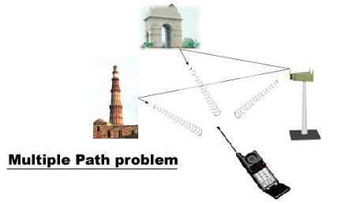
Multiple Path Problem
These different paths result in the receiver getting several versions of the same signal but at different times.

Slide 113
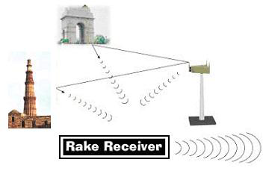

Rake Receiver
It is capable of receiving signals from multiple sources and adding them together.

Slide 114
KEY FEATURES - DIVERSITY
Frequency Diversity | Time Diversity | Space Diversity
transmission of signal on two frequencies spaced further apart than the coherence bandwidth | transmission of data at different times | Dual cell site receiver antennas, rake receivers, multi cell sites(soft handoff)
 | repeating the data ‘n’ times
 | interleaving and error correcting codes used in IS-95

Slide 115
POWER CONTROL
CDMA goal is to maximize the number of simultaneous users.
Capacity is maximized by maintaining the signal to interference ratio at the minimum acceptable level.
To resolve near far problem.
Power transmitted by mobile station must be therefore controlled.
Due to non-coherent detection at BS ,interference on reverse link power control is more critical.
The transmit power for each user must be reduced to limit interference.
The power should be enough to maintain the required (signal to noise ratio) for a satisfactory call quality.

Slide 116
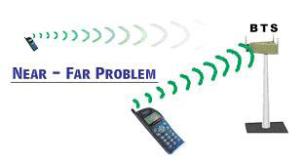
Need for Power Control
If all handsets transmit the same power level, the base station will receive unnecessarily strong signals from handsets nearby and extremely weak signals from handsets that are far away.

Slide 117
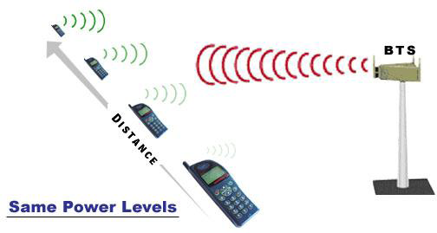
What is Power Control?
Power control enables handsets to adjust the power at which they transmit

Slide 118
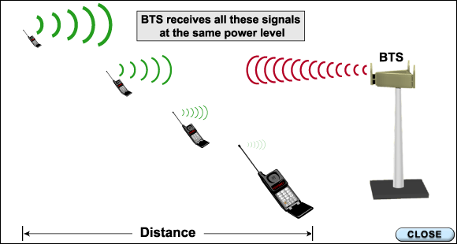
Power Control Contd…
The CDMA network independently controls the power at which each mobile transmits.
Both forward and reverse links use power control techniques.

Slide 119
Power Control Contd…
Open loop
Mobile estimates the loss and makes necessary adjustments
Closed loop
The base station monitors the S/N ratio and gives commands

Slide 120
CDMA HANDOFFS
CDMA has three primary types of handoff:
soft
hard
idle
The type of handoff depends on the handoff situation.

Slide 121
Soft Handoff
A soft handoff establishes a connection with the new BTS prior to breaking the connection with the old one.
Soft handoffs are also called "make-before break."

Slide 122
Hard Handoff
A hard handoff requires the mobile to break the connection with the old BTS prior to making the connection with the new one.
Hard handoffs are also called "break-before make."

Slide 123
Idle Handoff
An idle handoff occurs when the phone is in idle mode.
An idle handoff occurs without any assistance from the BTS.

Slide 124
ADVANTAGES
Universal frequency reuse
Fast and accurate power control
Different types of handoff
Rake receiver
Coverage
Capacity
Clarity
Cost
Compatibility
Customer satisfaction

